Slide 1
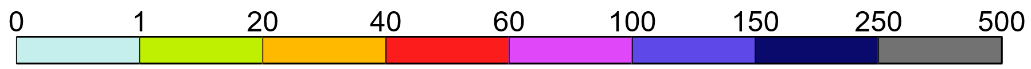
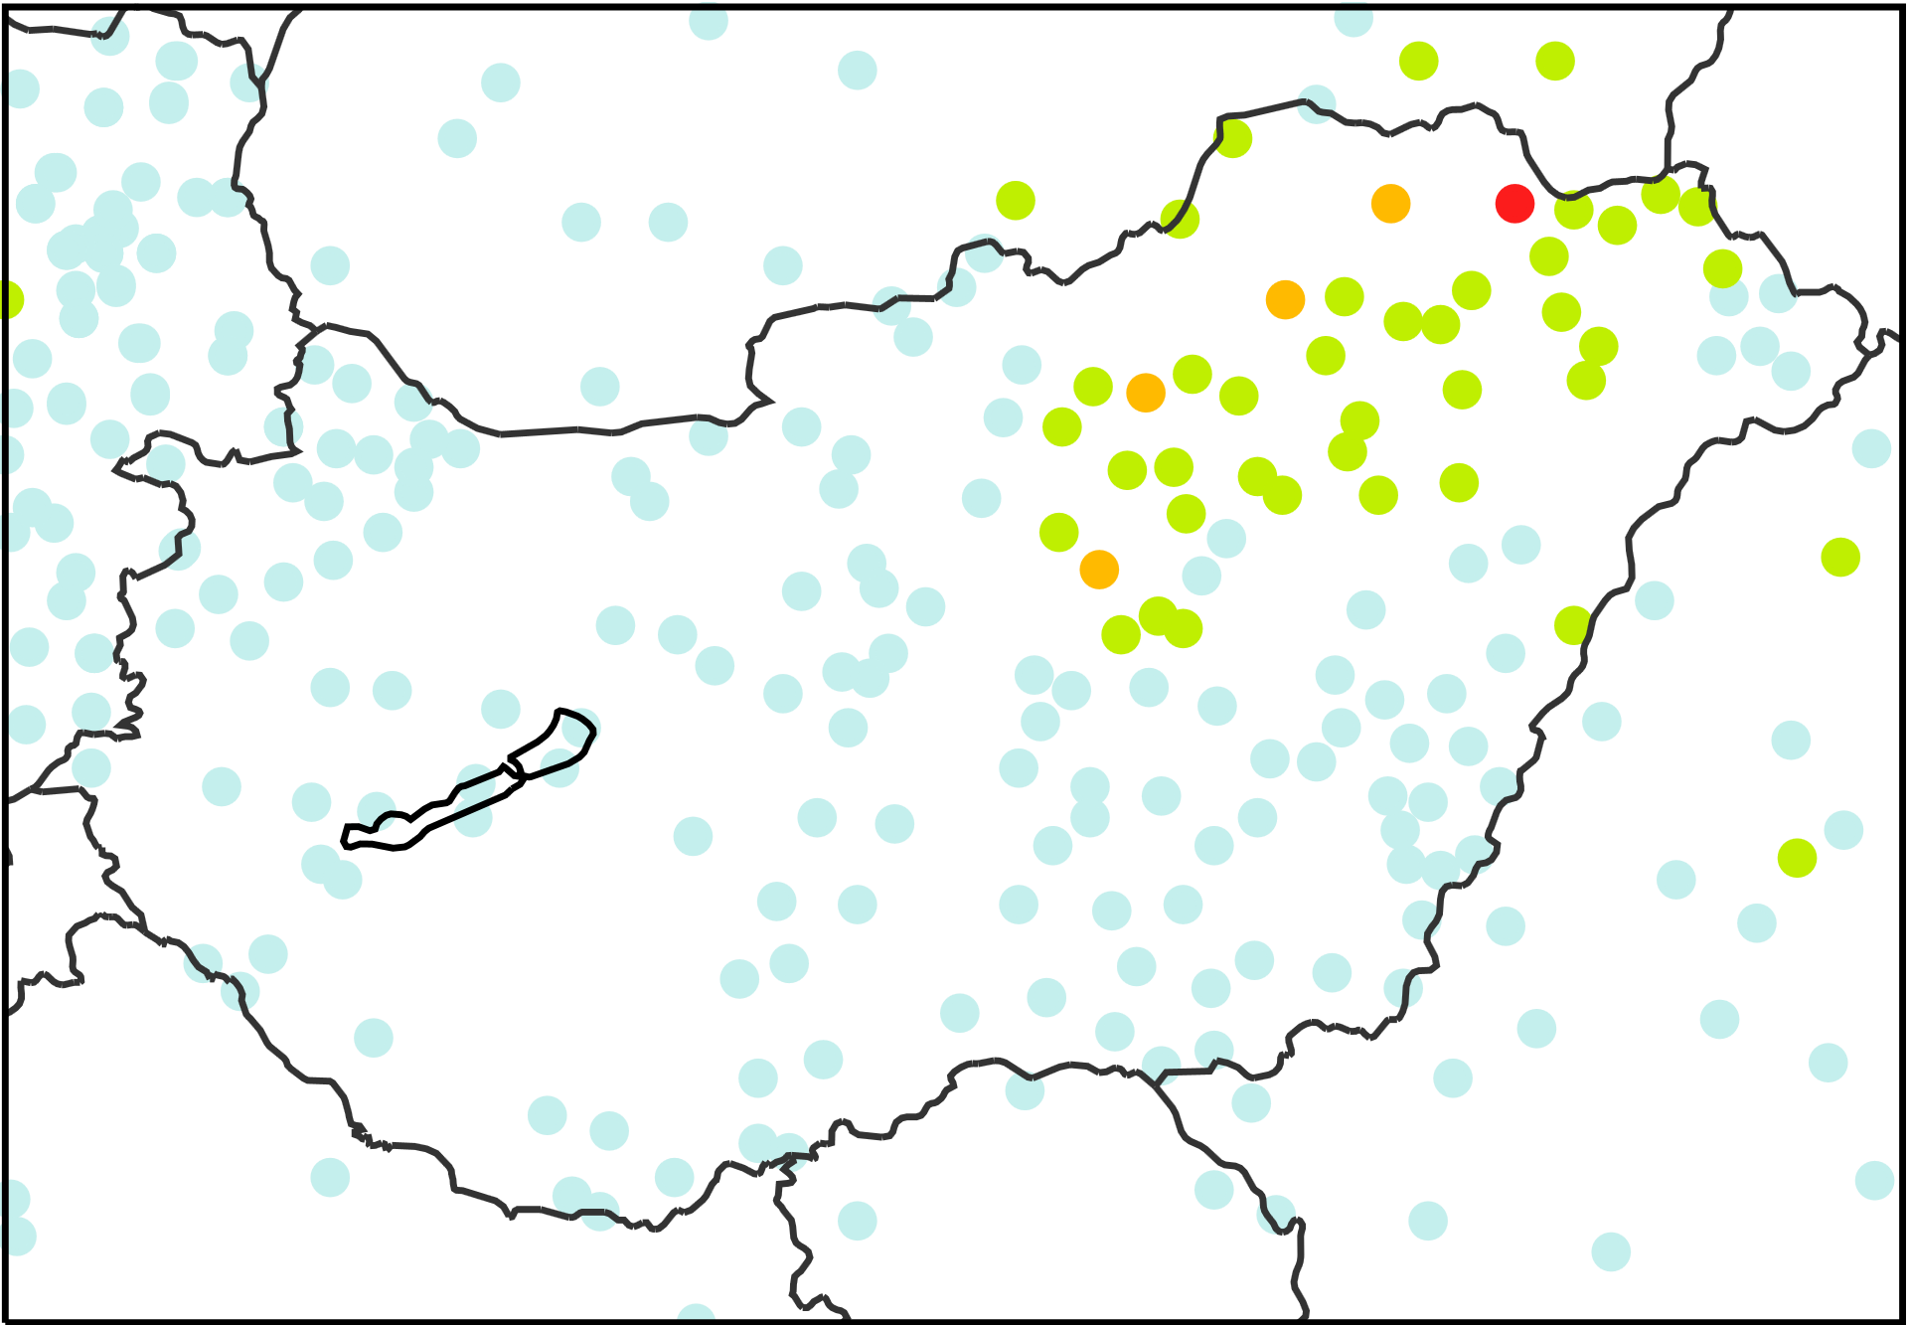
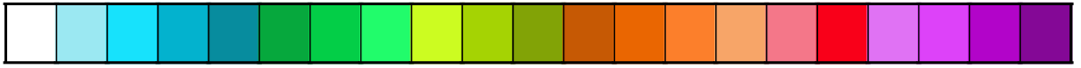
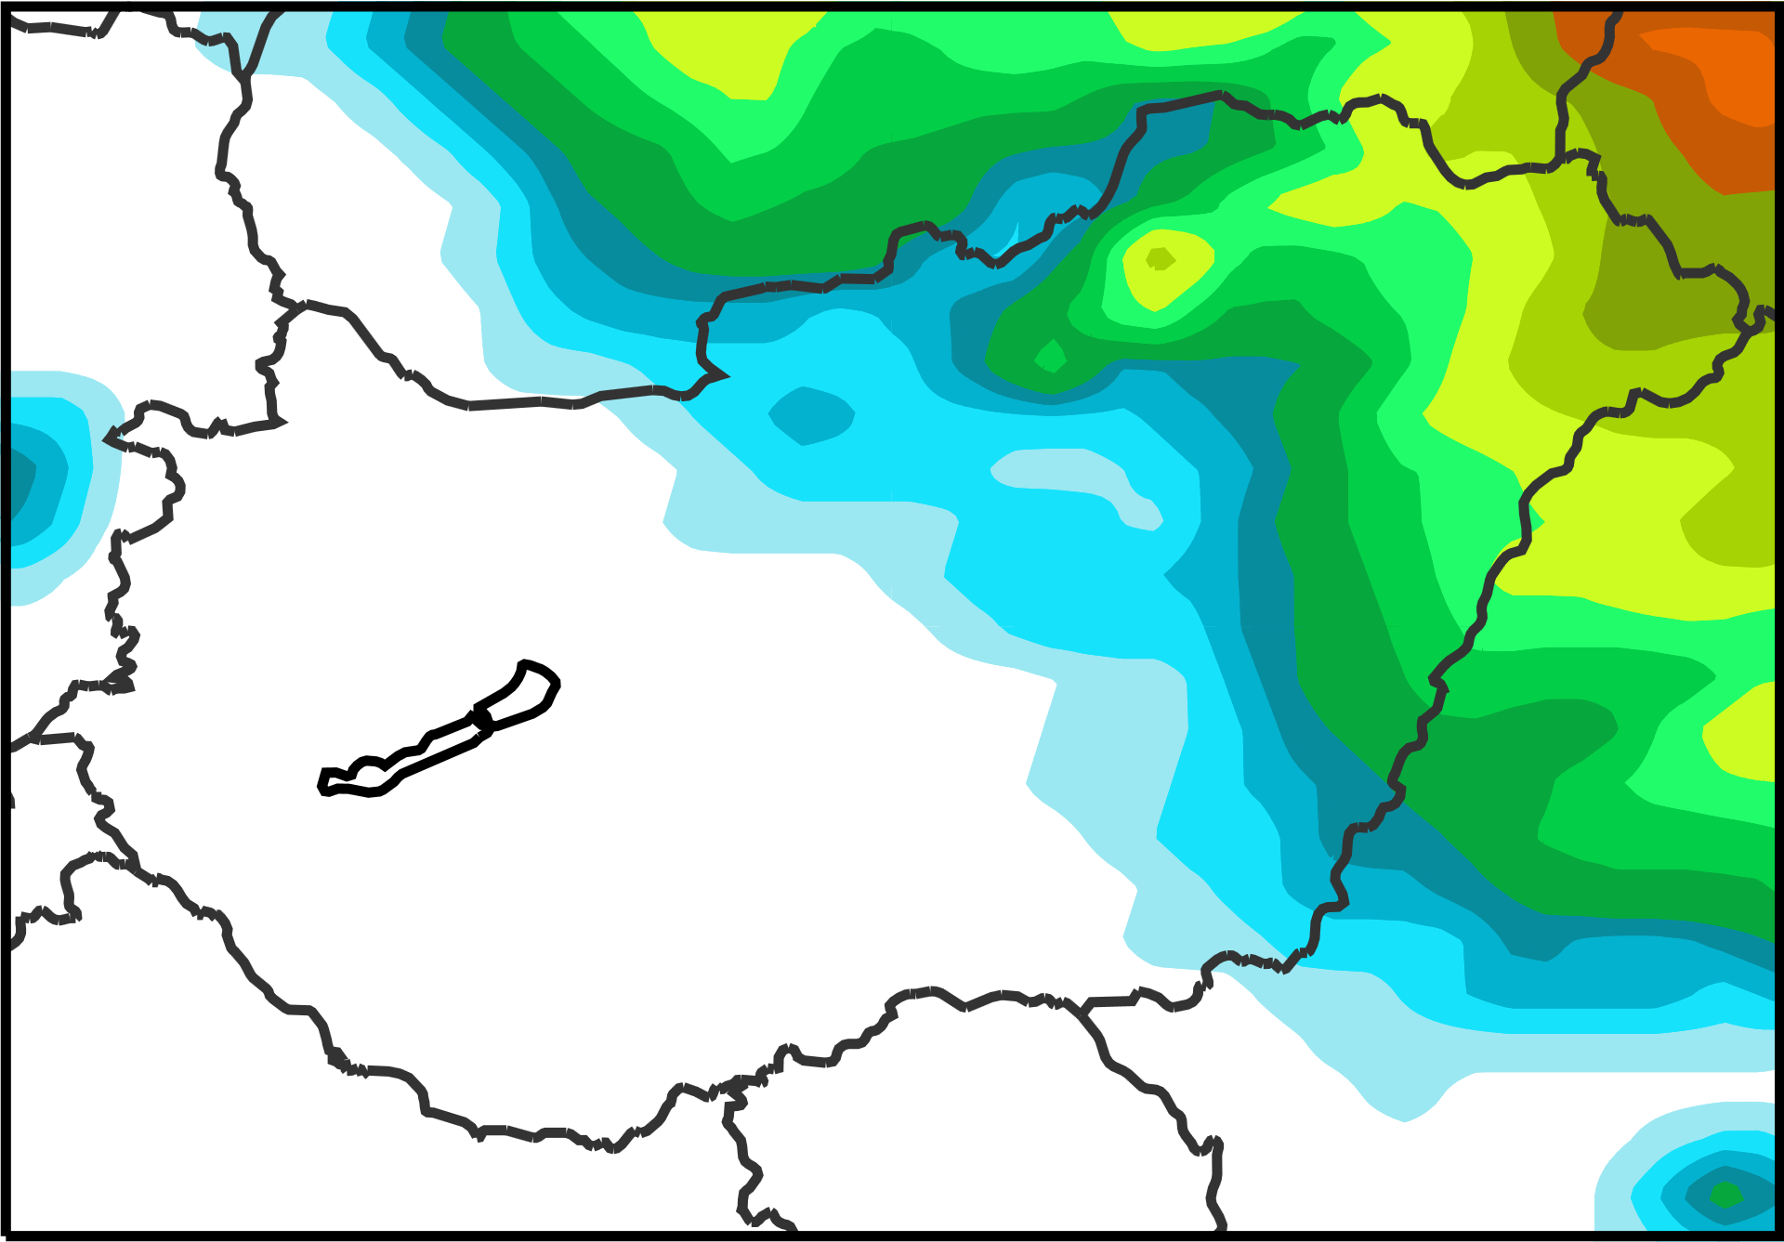
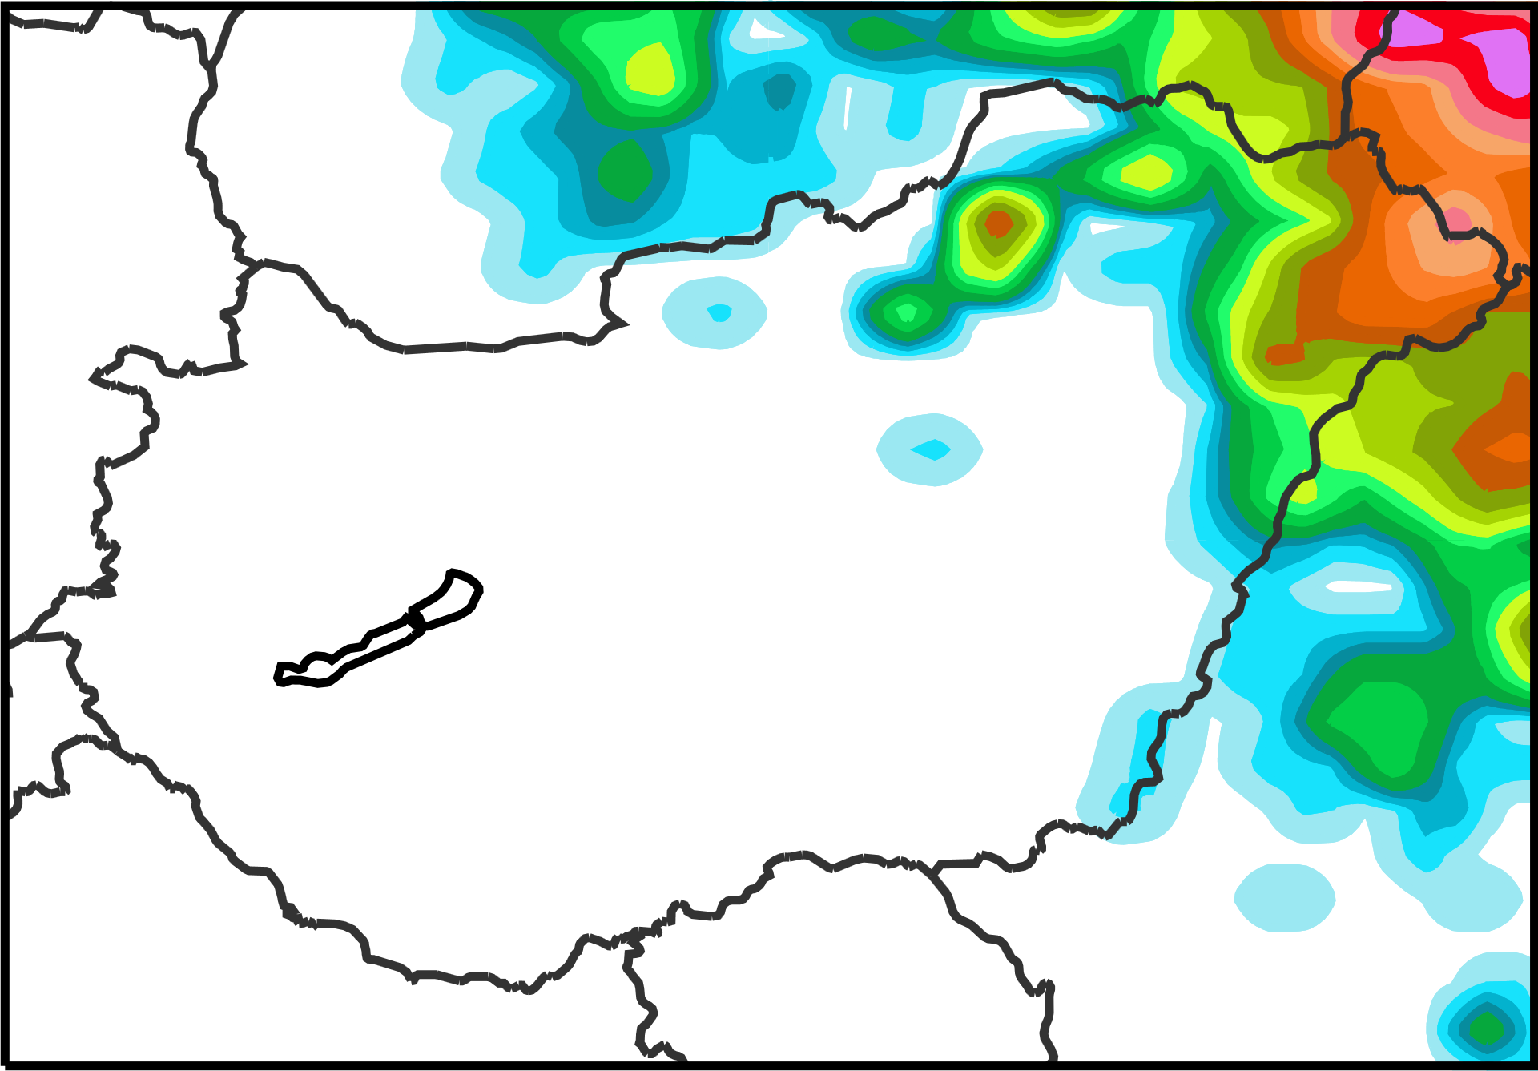
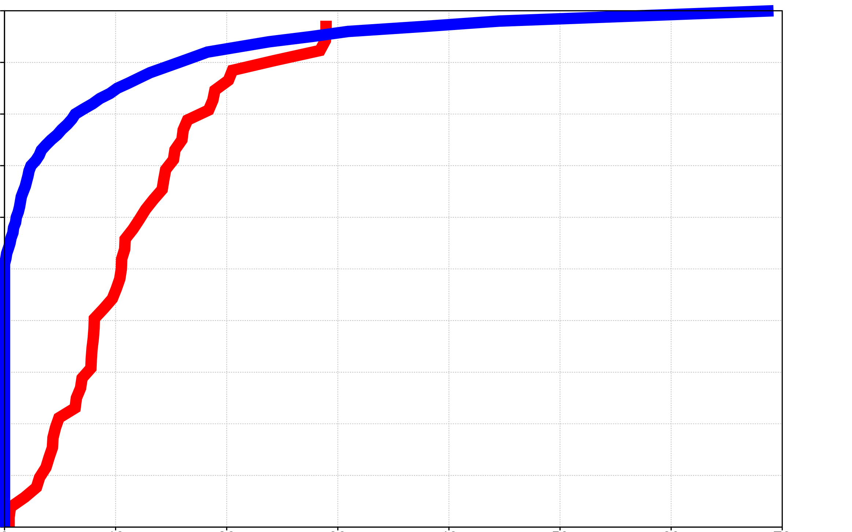
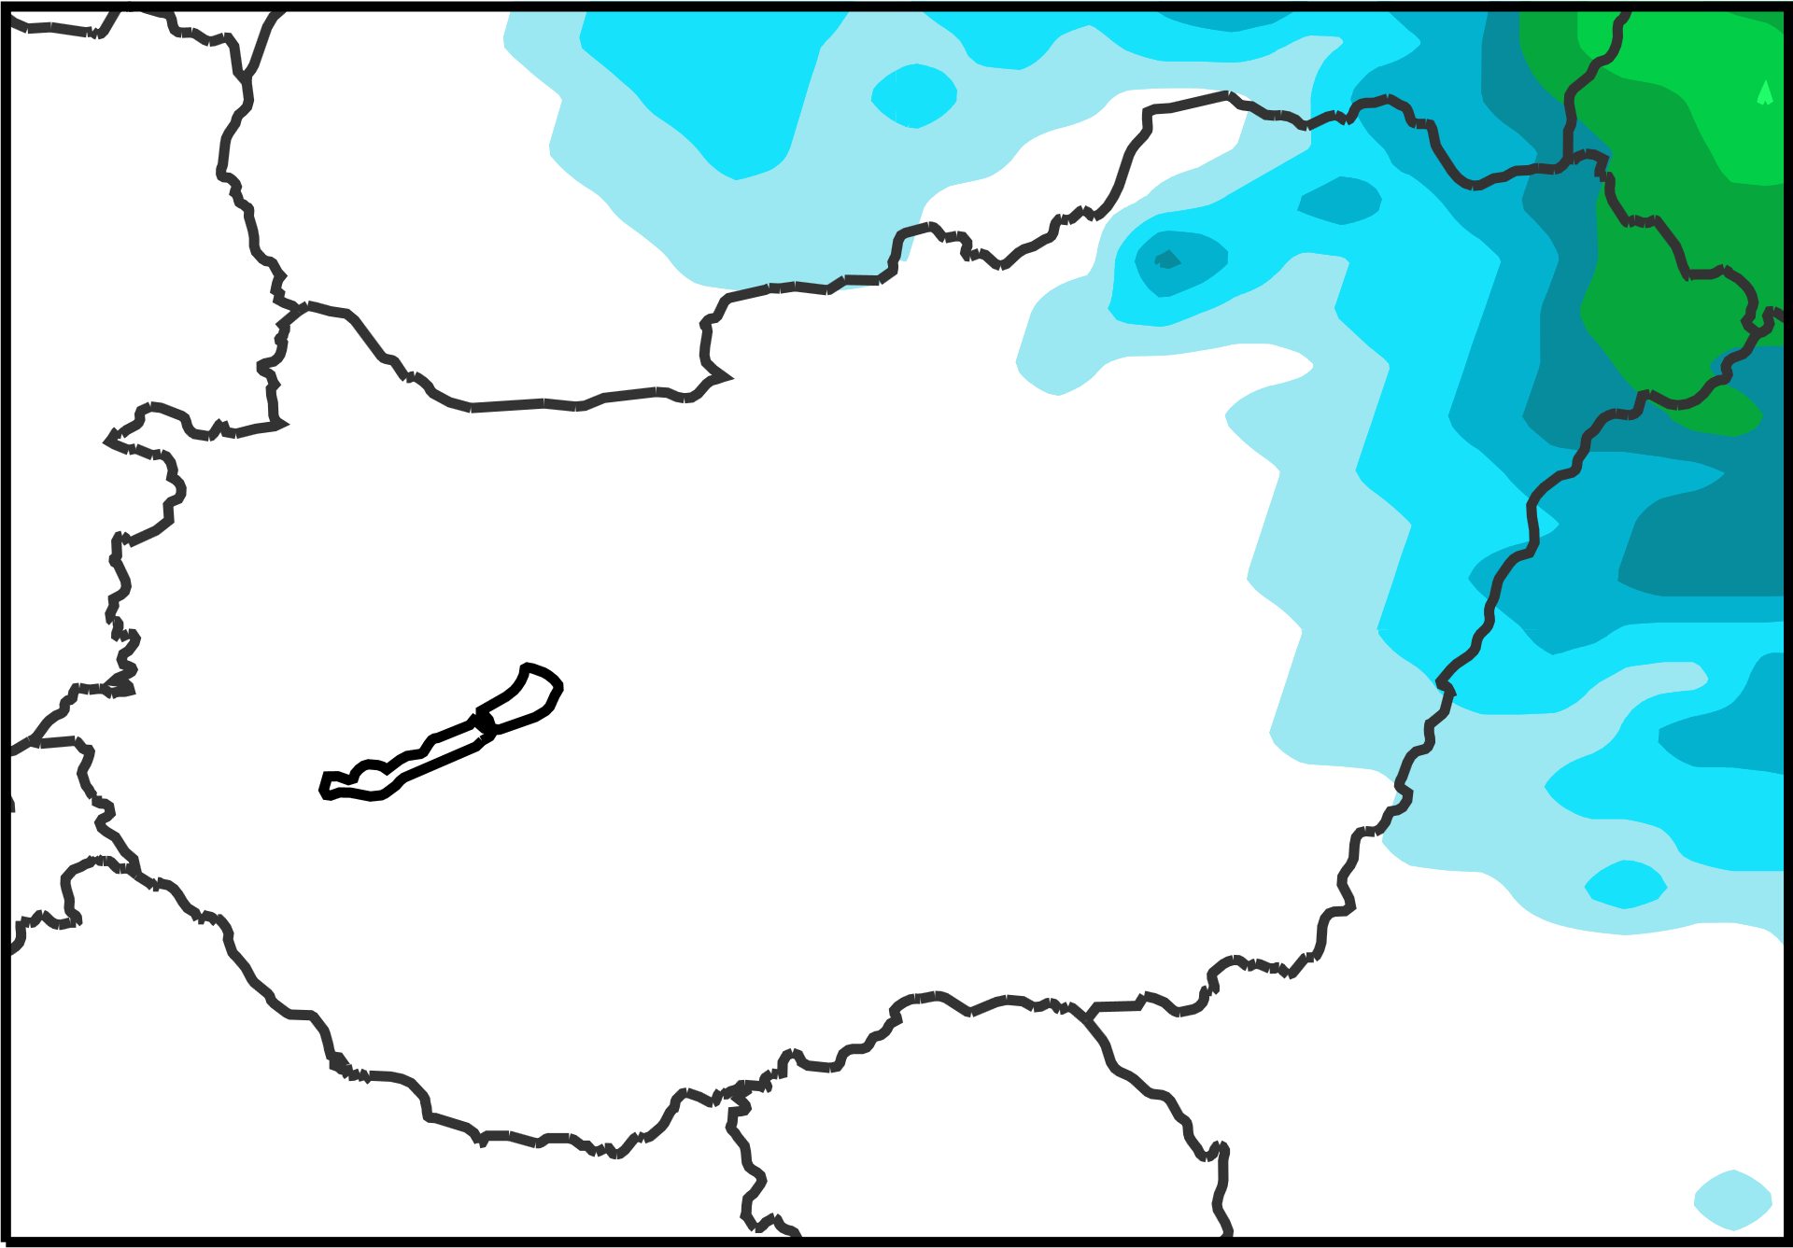
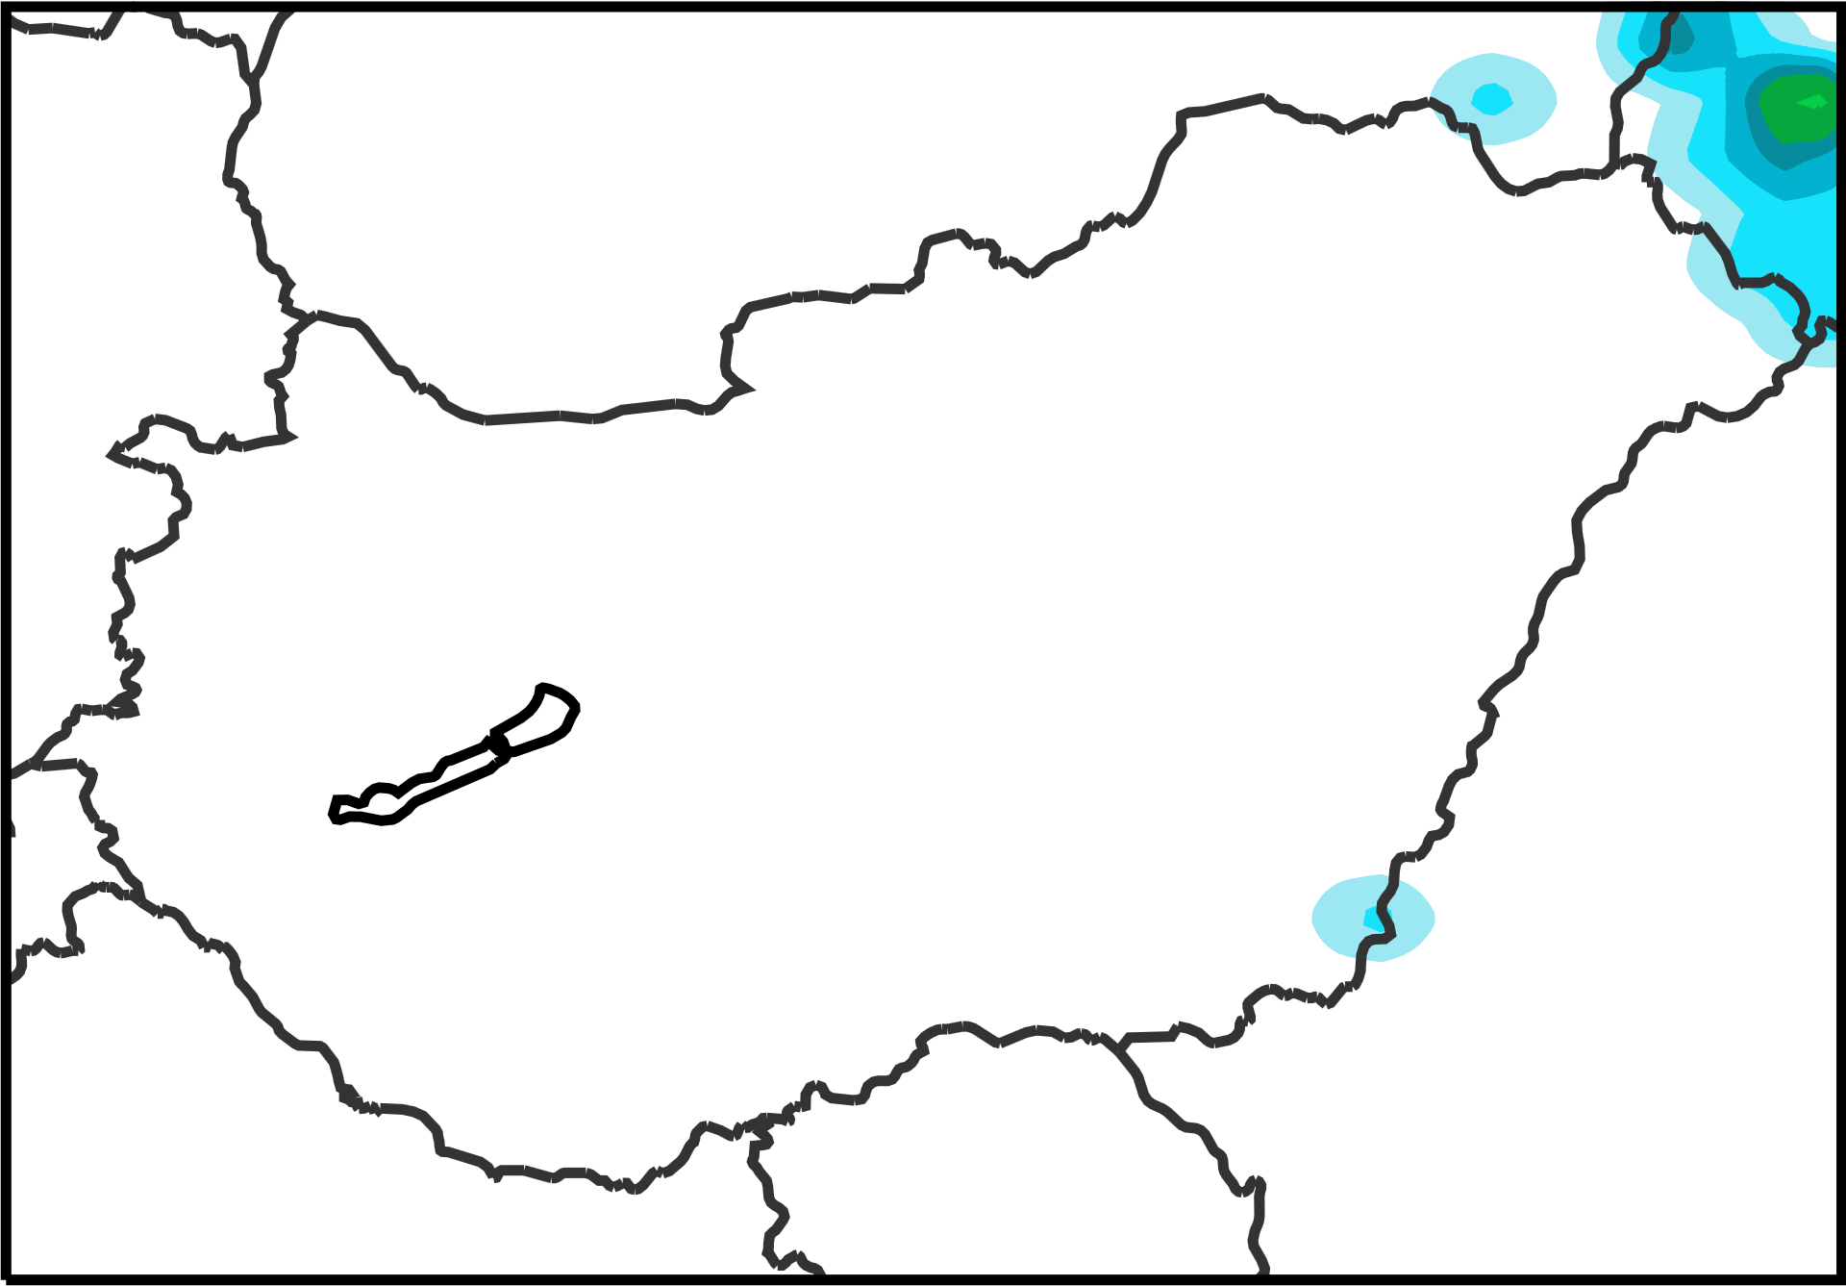
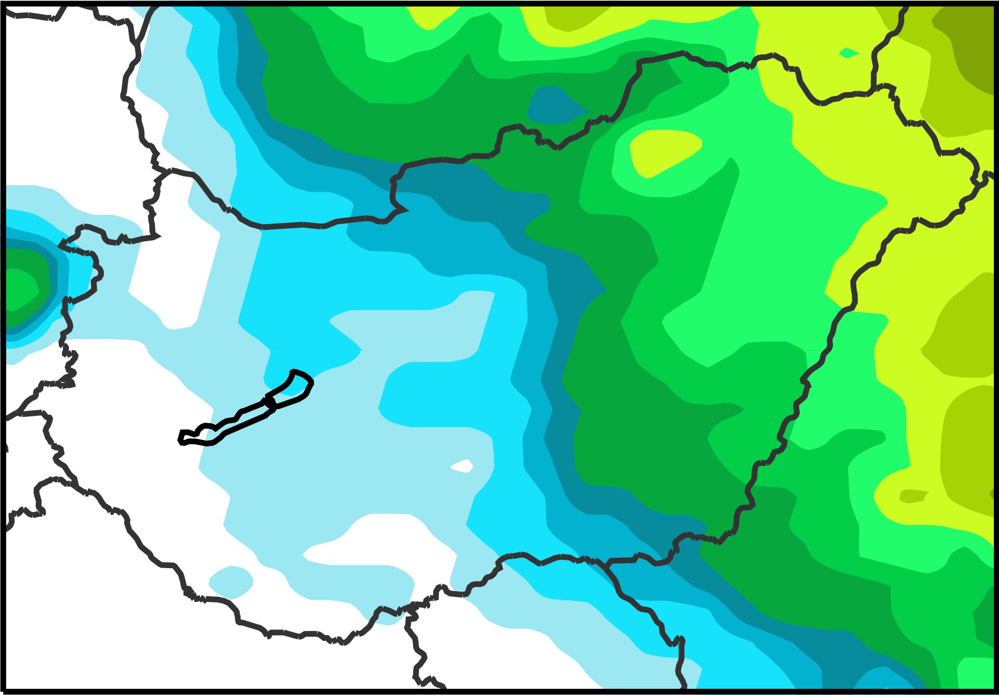
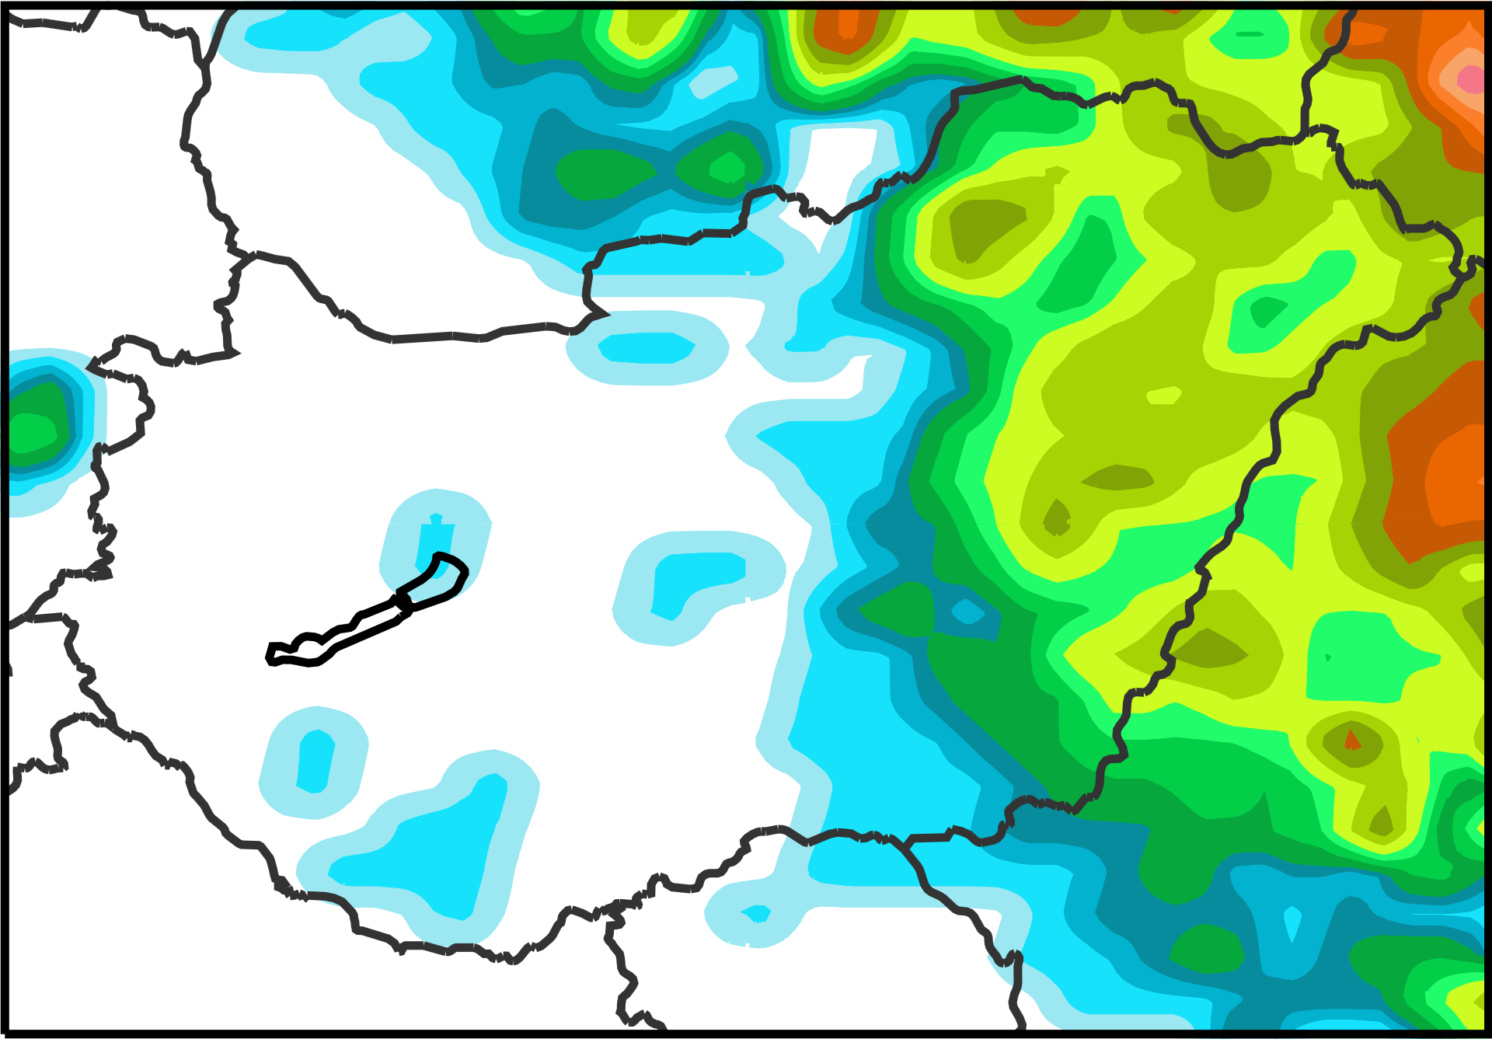
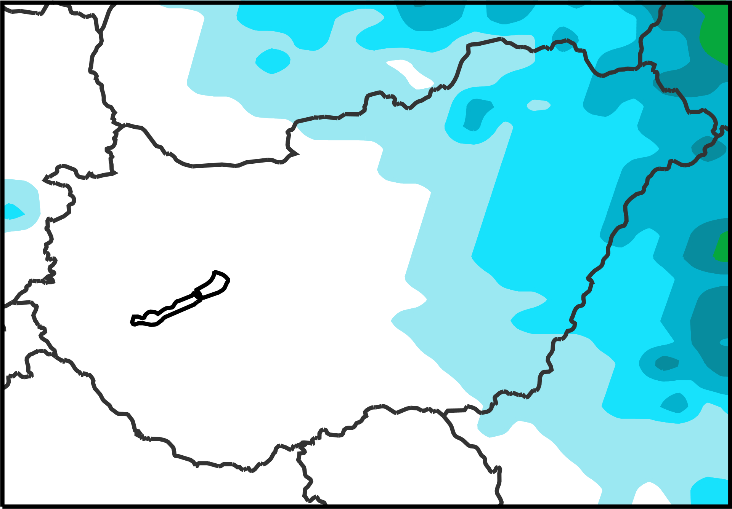
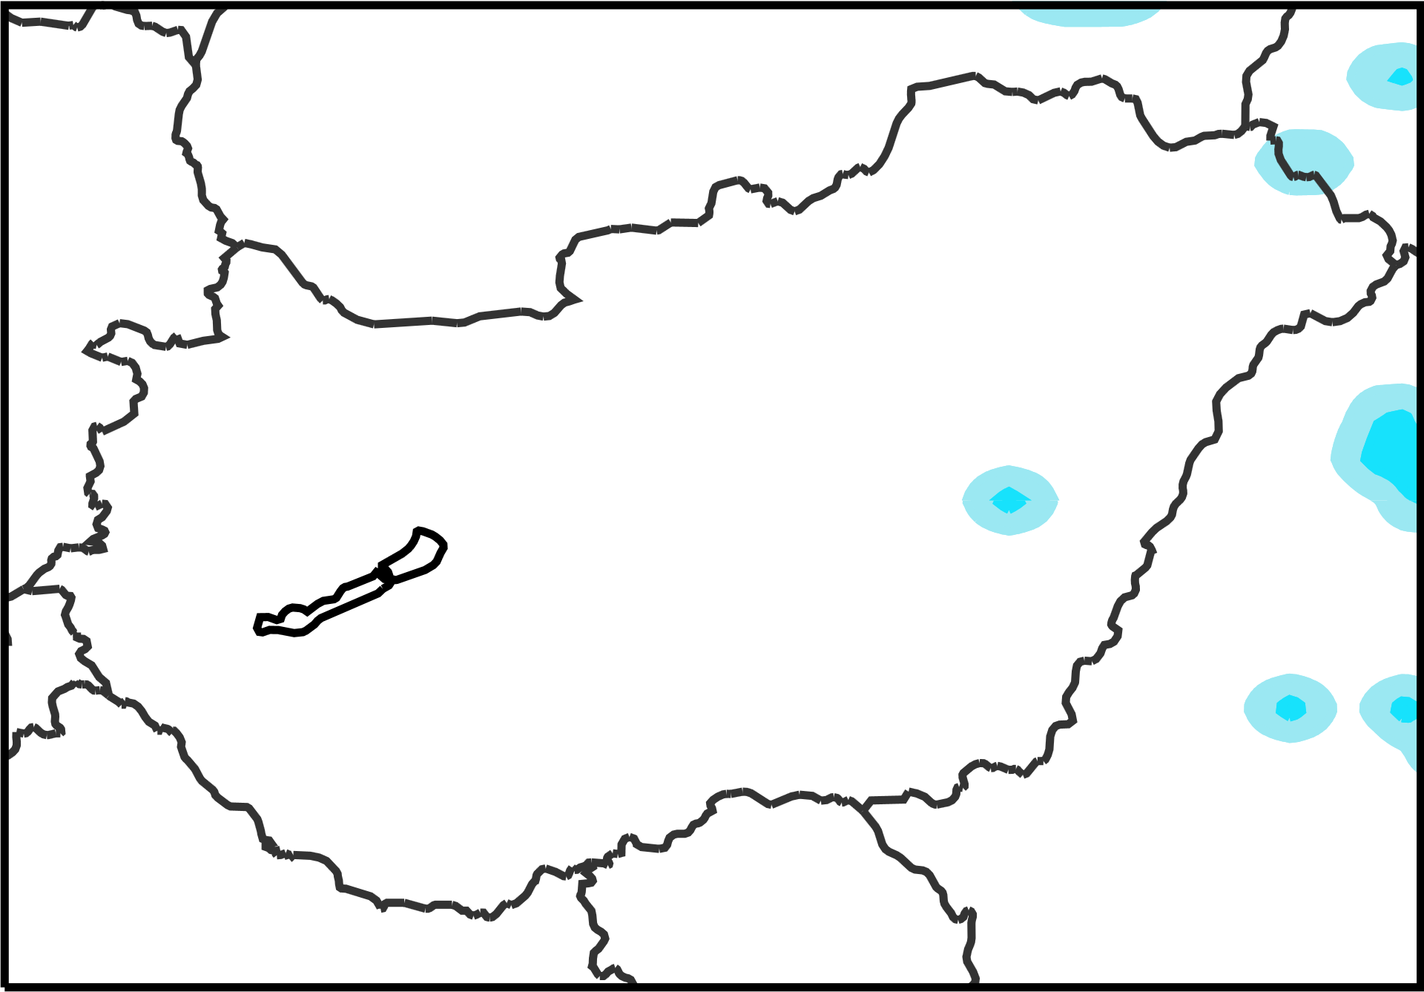
mm / 12h
2018/06/11 0 UTC to 2018/06/11 12 UTC
X
a
0
0.5
1.5
2.5
3.5
4.5
6.5
8.5
10.5
13.5
16.5
20.5
25.5
30.5
35.5
40.5
50.5
60.5
70.5
80.5
90.5
100
[%]
ecPoint – Rainfall
Raw ENS
X
d
X
Prob. Non Exc.
10 mm/12h
100
50
ecPoint-R
b
Prob. [%]
ECMWF ENS
0
2018/06/10 00 UTC (t+24,t+36), DAY 2
0
30
70
X
Rain [mm/12h]
X
X
Prob. Non Exc.
30 mm/12h
c
e
Prob. Non Exc.
10 mm/12h
f
h
2018/06/08 00 UTC (t+72,t+84), DAY 4
Prob. Non Exc.
30 mm/12h
g
i

